Slide 1
Employee salary analysis
Subtitle – Data analysis project
Gokulnath e

Slide 2
Project Objectives
The main goal of this project is to analyze employee salary data using Python, SQL and tableau to understand different patterns and trends in the company. The analysis focuses on how salary, age, and job roles affect employee distribution and performance.

Slide 3
Objectives:
To study average salary across different departments and positions.
To analyze employee age groups to know workforce experience levels.
To see employee distribution by country and understand global presence.
To track employee joining trends over the years to find hiring patterns.
To identify top salary earners and understand how salary varies by role.

Slide 4
Software used for analysis
Python
Pandas
Matplotlib
Seaborn
SQL
Tableau

Slide 5
Data visualization Charts & dashboard

Slide 6
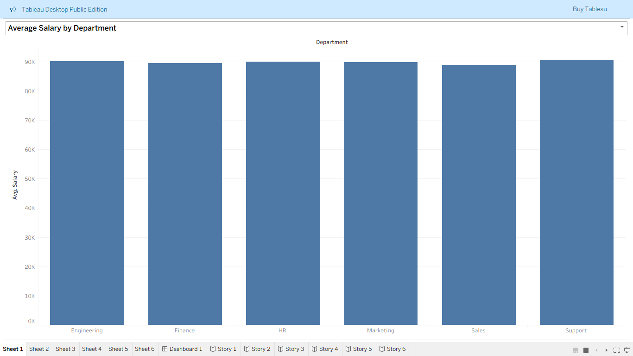

Slide 7
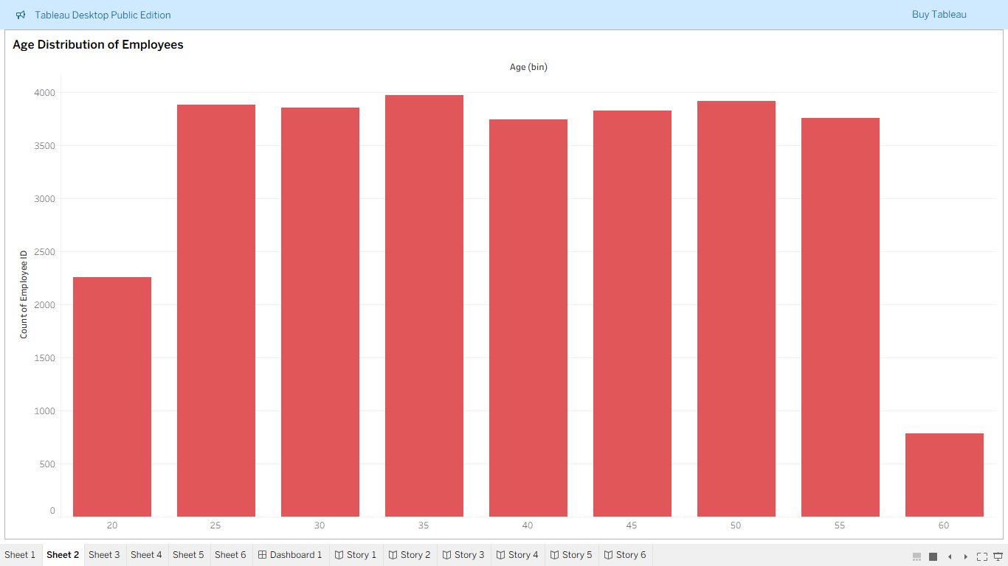

Slide 8
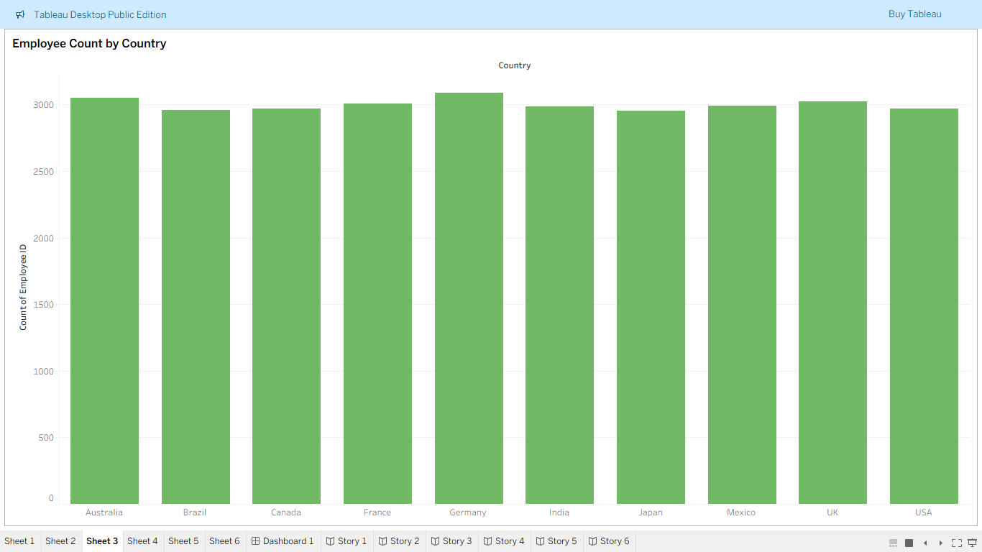

Slide 9
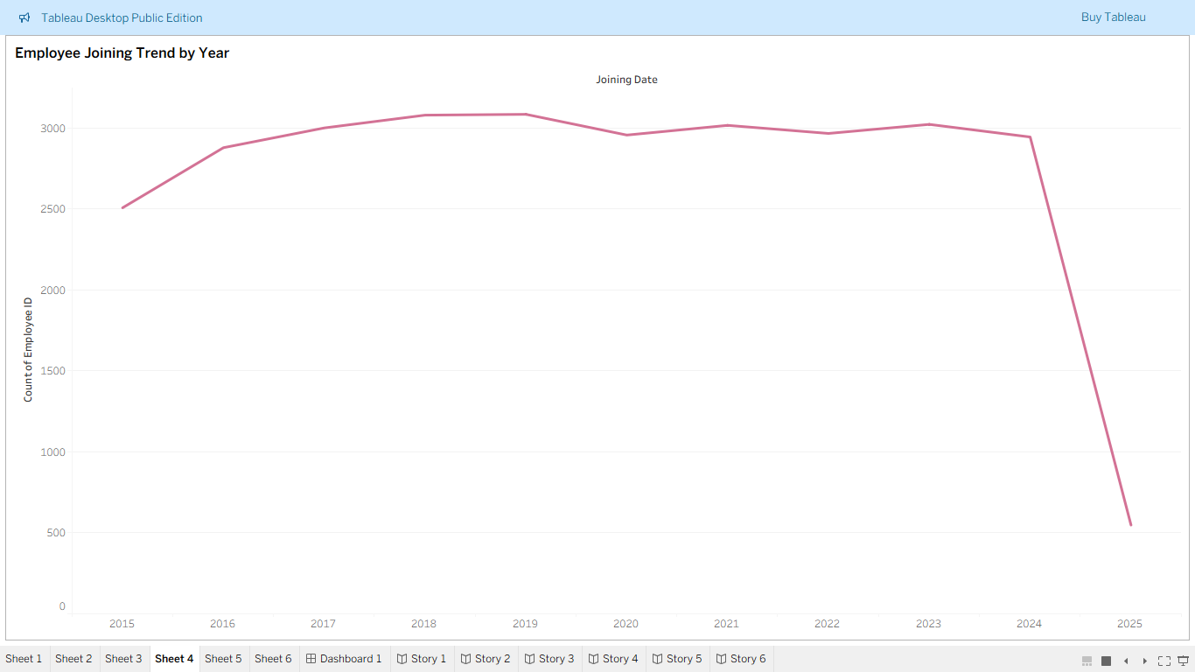

Slide 10
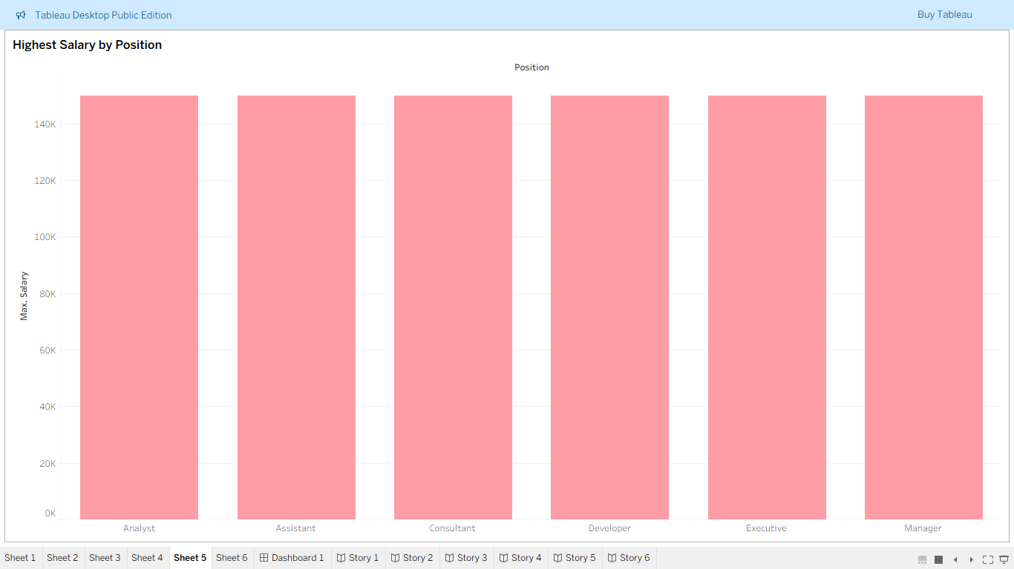

Slide 11
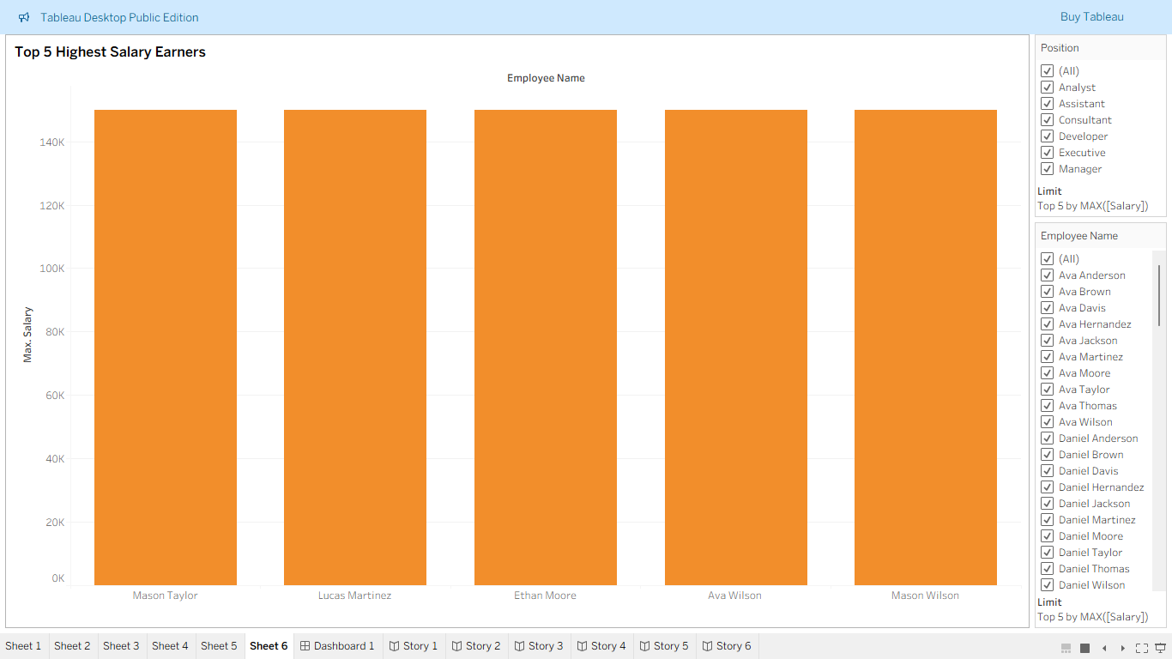

Slide 12
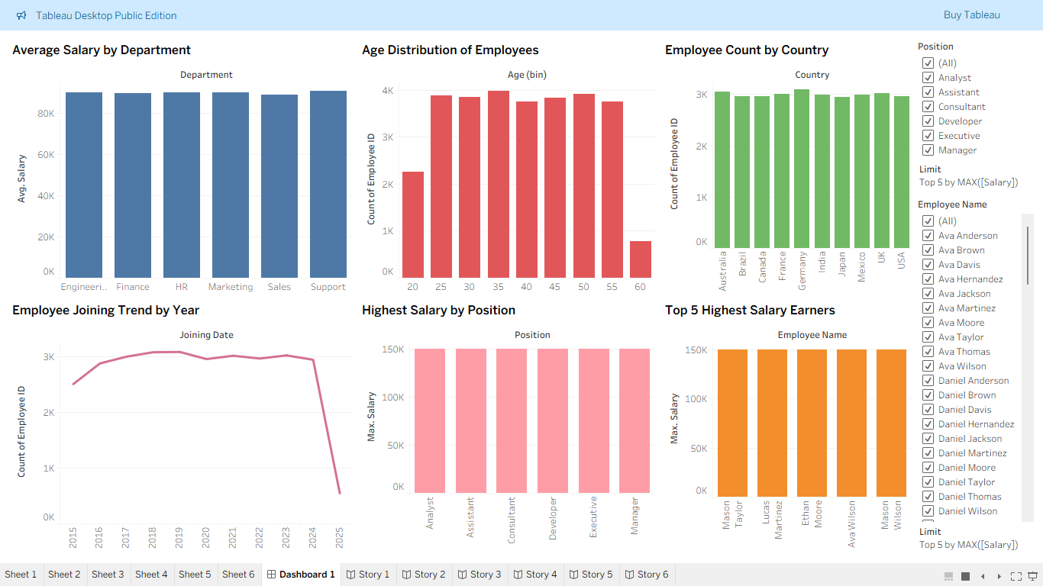

Slide 13
Insights
All departments have almost the same average salary, around 85K to 90K. Managers and Executives earn the highest salary, about 150K. This shows the company gives fair and equal pay to everyone.
Most employees are between 30 to 50 years old, which means the company has more experienced workers. There are very few employees below 25 or above 55.
Employees work in many countries like India, USA, UK, Germany, and Canada. The number of employees is almost the same in all countries, showing a good global balance.

Slide 14
Employee joining increased from 2015 to 2022, then dropped a little after 2023. This shows the company grew well but slowed down hiring recently.
The top 5 employees earn around 150K and are likely in senior or important roles. This shows that the company rewards high-performing employees.
Overall, the company has a fair salary structure, experienced workers, global presence, and steady growth with equal opportunities for everyone.

Slide 15
Thankyou

